Slide 1
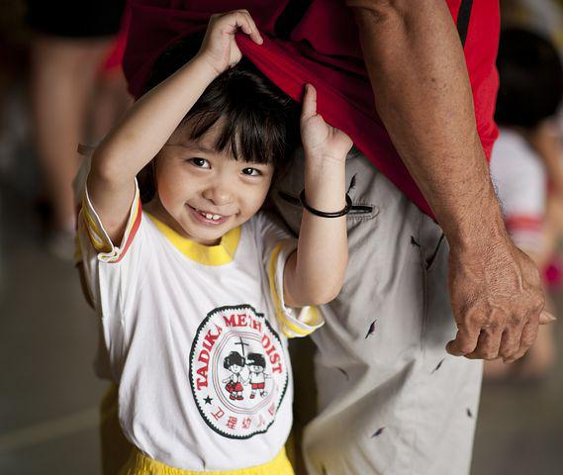

Starting School
This is me. My name is __________________
I will be starting __________________________ school soon.
©2022

Slide 2
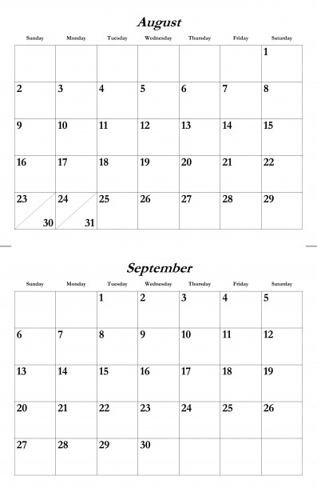
Parents – if it helps, please highlight the date your school will go to school in one colour (plus all the days afterwards they will go). Then use the dates before to add a colour for being at home or other activities you will be doing.
©2022

Slide 3
This is what my school looks like…
My classroom | My teacher
My TAs | The hall
The playground | The carpet
©2022

Slide 4
My first day:
Add a visual schedule here – include a ‘home’ symbol at the end.
The important places in school:
Add photos of their favourite activities, toilets, cloakroom and sensory safe place.
©2022

Slide 5

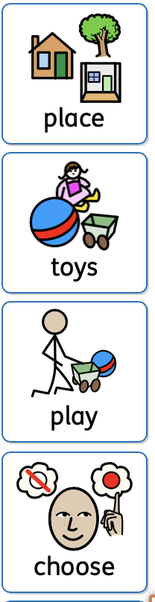
School is a place most children go to.
School has other children that go there too.
I will usually see the same children each day.
I usually have the same teachers each day.
We don’t go to school at the weekend.
I can take my lunch to school or have a dinner that is made at school. I can choose what I want to eat.
My teachers job is to help me. They might show me how to do things and they might play alongside me.
If I am upset, my teachers can help me go to a quiet place.
All the toys in the class belong to the class.
Other children might want to play with the same things as me.
We can have some time and then pass it on. Or play with it together, or go and find something else to paly with.
©2022

Slide 6
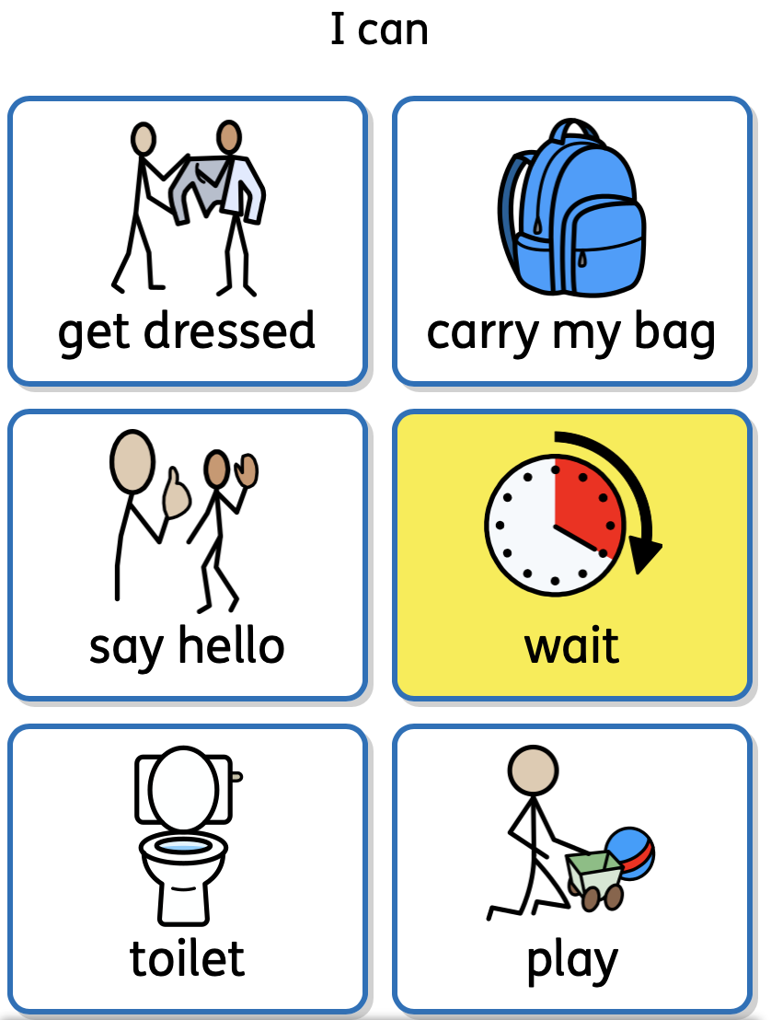
I can practice:
.
©2022

